Slide 1


Lecture
Introduction to programming

Slide 2
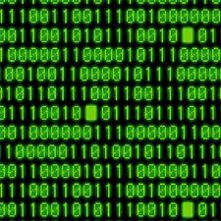
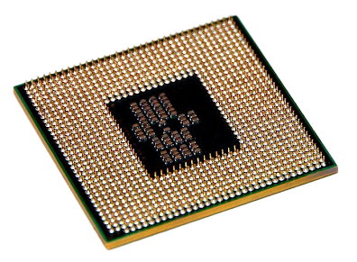
Introduction to programming
(Machine level language)
(Assembly level language)
(Machine level language)
ADD
SUB
DIV
Assembler
MLL
Processor(CPU)
ALL
MLL
Processor(CPU)
High-level
programming language
C, Pascal, Java, Python.
Advantages :
User friendly easy to write code in symbols and by using english like commands.
Compiler
Processor(CPU)
(Machine level language)

Slide 3
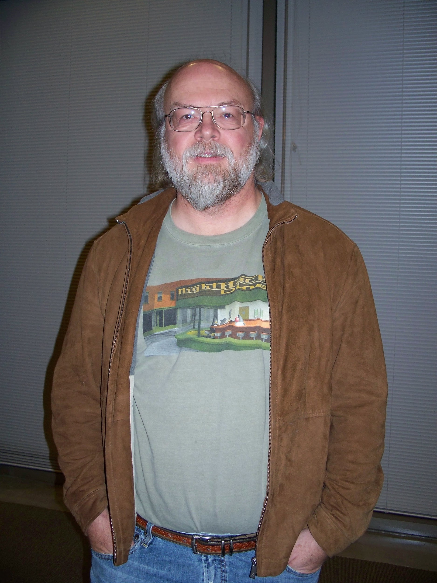




Introduction to Java
Freely downloadable
Open source
Created by Sun Microsystem
Currently owned by Oracle corporation
1995
James Gosling
Green Team

Slide 4

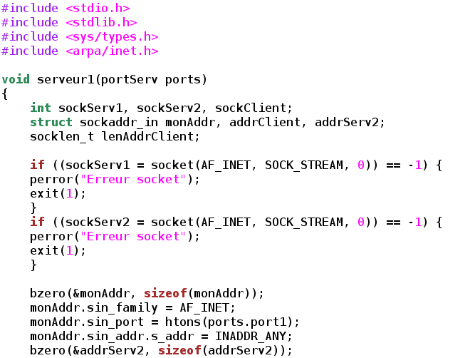


Platform and Platform Dependency(Non- Potability)
Windows
C program code
MLL
Compiler
Output
Add.c
Add.obj
(Machine level language)
Add.exe
Processor(CPU)
Linux
Processor(CPU)

Slide 5

How Java Made Portable(Platform Independent - WORA)
Java Code (.java)
JAVAC
Compiler
The Bytecode (.class) file will be created in one System OS.
That bytecode will be transported through internet and will be downloaded in other OS.
The other OS will have there on JVM installed which will help that .class file of java code to run in there system.
Through this java got Platform Independent which we call WORA.
Java Code (.java)
JAVAC
Compiler
Byte Code (.class)
JVM
JVM
JVM
Byte Code (.class)
Windows
Linux
Mac
JVM
JVM
JVM
Windows
Linux
Mac

Slide 6
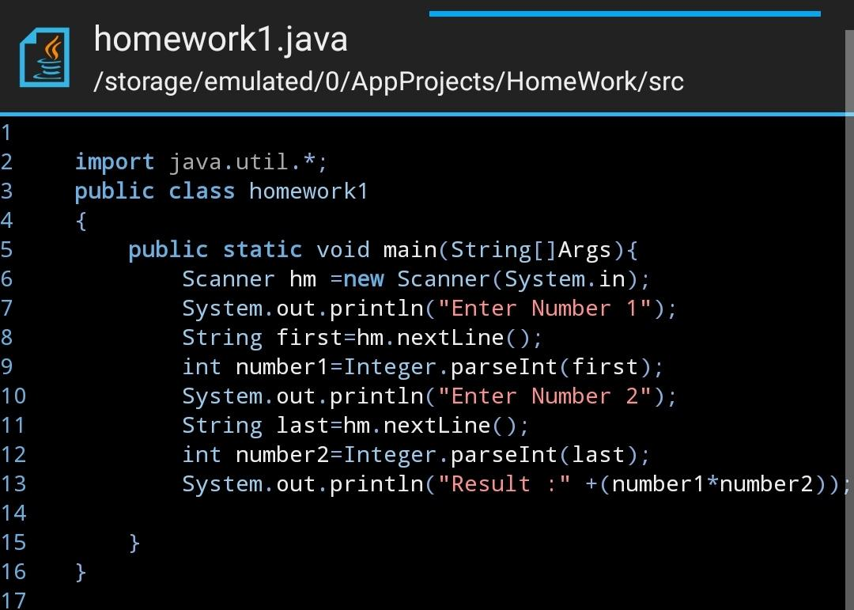
How Java Made Portable(Platform Independent - WORA)
Java Code (.java)
JAVAC
Compiler
Byte Code (.class)
JVM
Compiler
Internet
JVM
JVM
JVM
.CLASS FILE
Internet
JVM
Windows
Linux
Mac
JVM

Slide 7
Classes and Objects (Basics)
Class:
The classes and objects in Java, along with their characteristics and methods, are the foundation of everything.
A class is a collection of objects that have similar traits, behaviours, and attributes.
Object:
An object is an entity with state and behaviour.

Slide 8







State
Behaviour
Name
Starts
Color
Stops
Price
Drive

Slide 9
THANK YOU

